Slide 1
Open slides

Slide 2
Reprex: a modern data observatory

Slide 3
Big data creates inequalities
Only the largest corporations, best-endowed universities, and rich governments can afford data collection and processing capacities that are large enough to harness the advantages of AI.

Slide 4
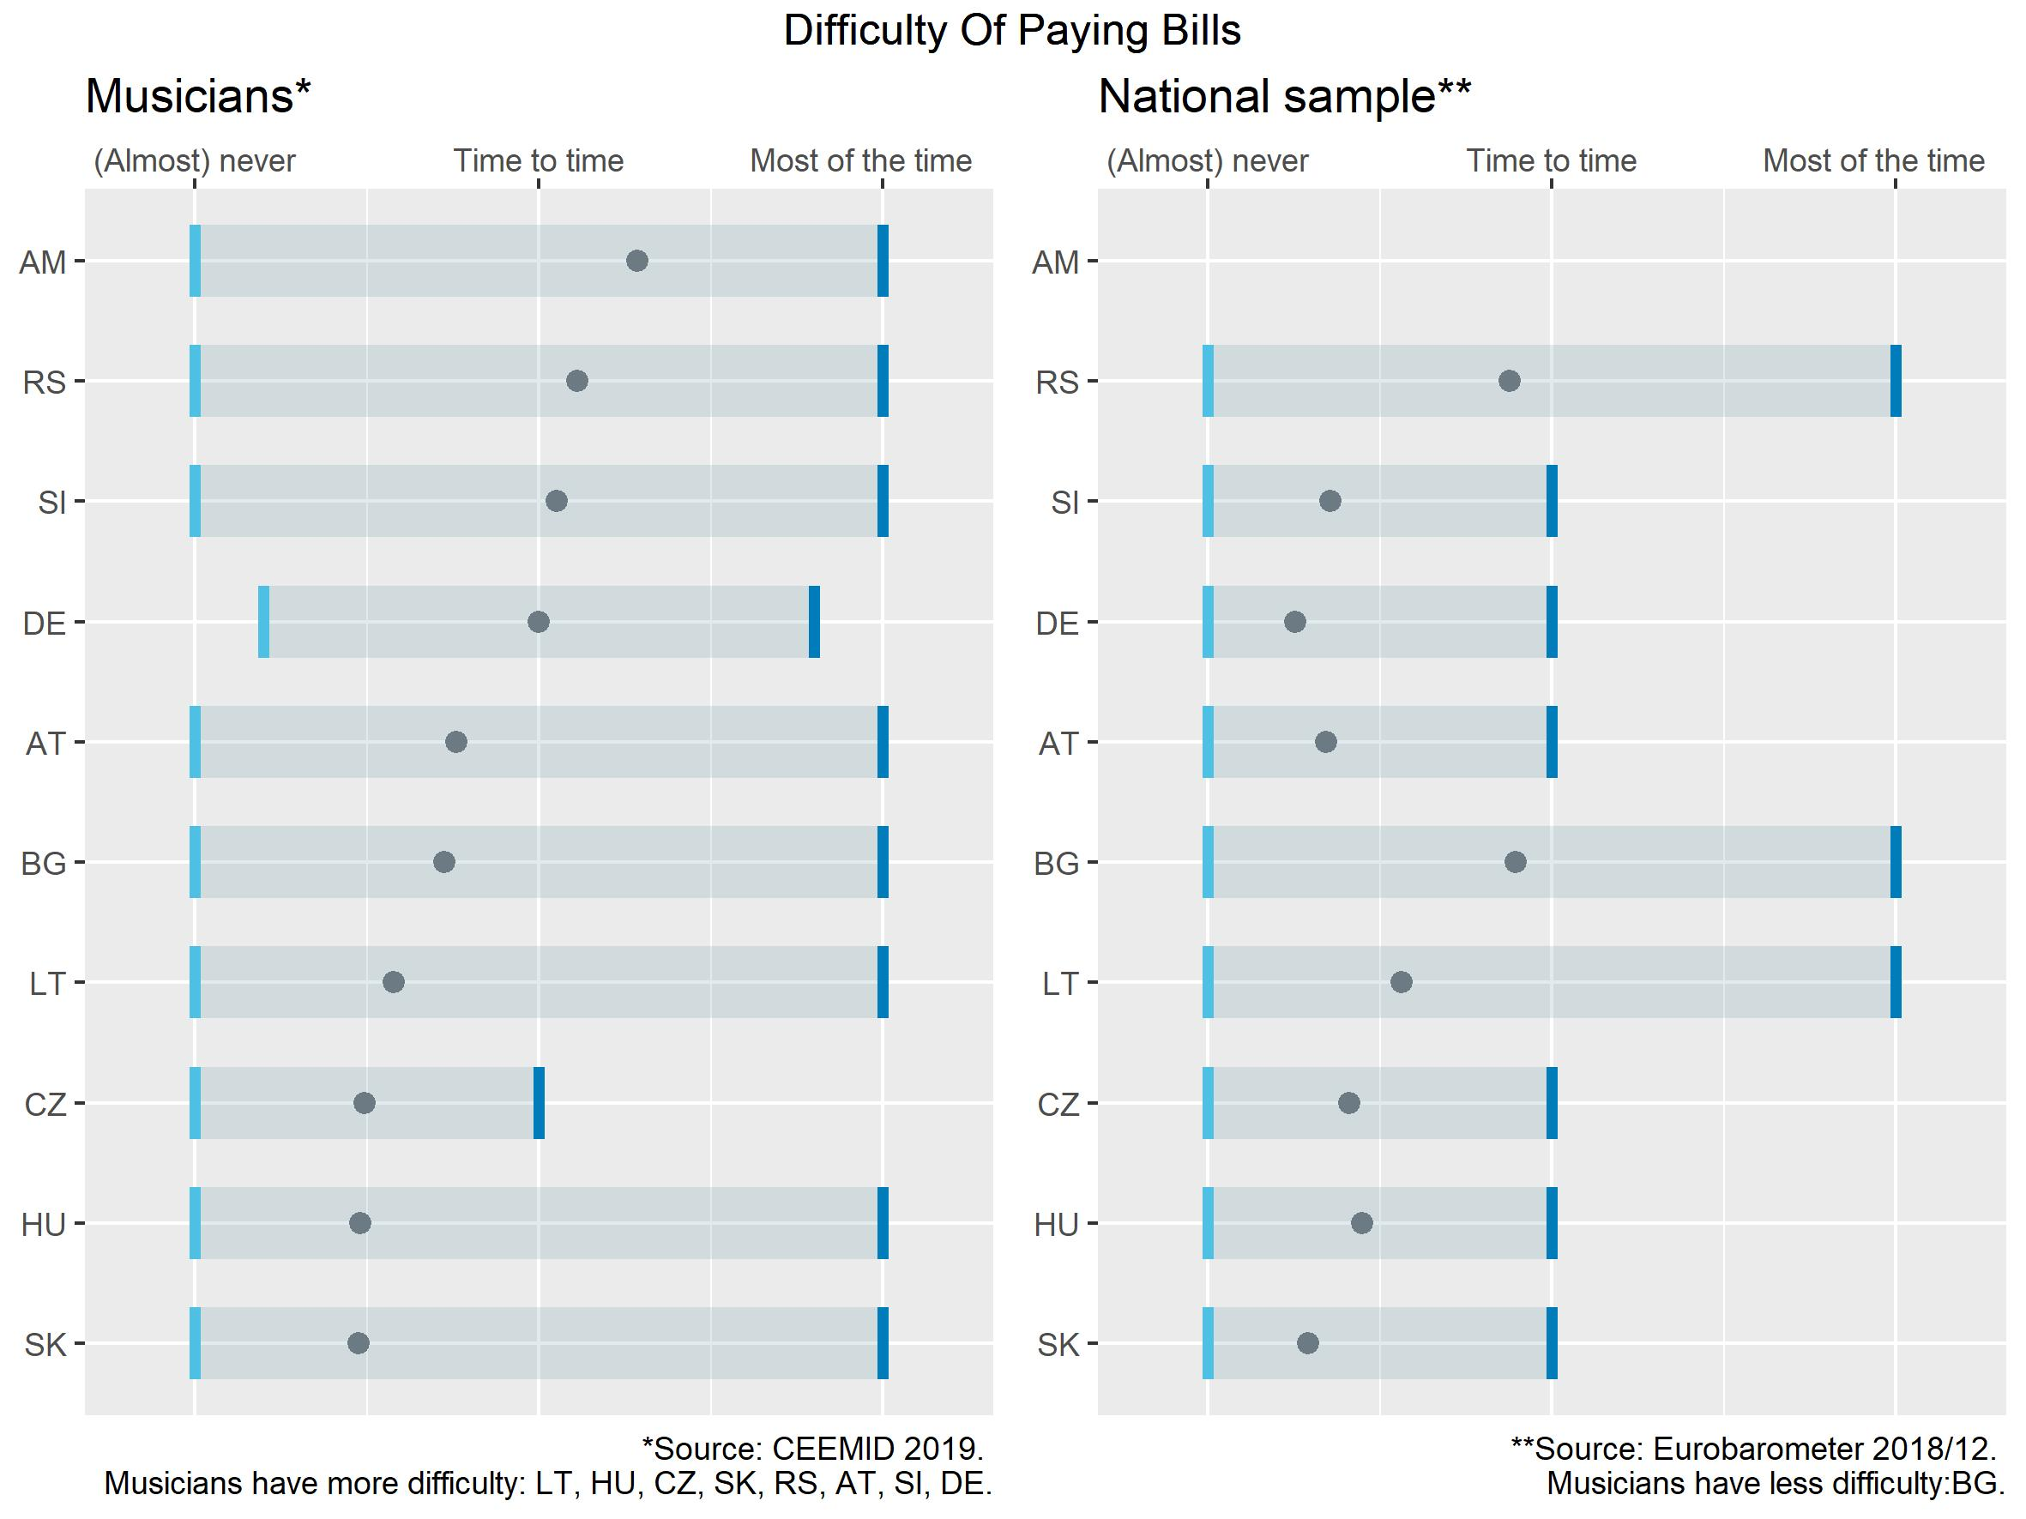
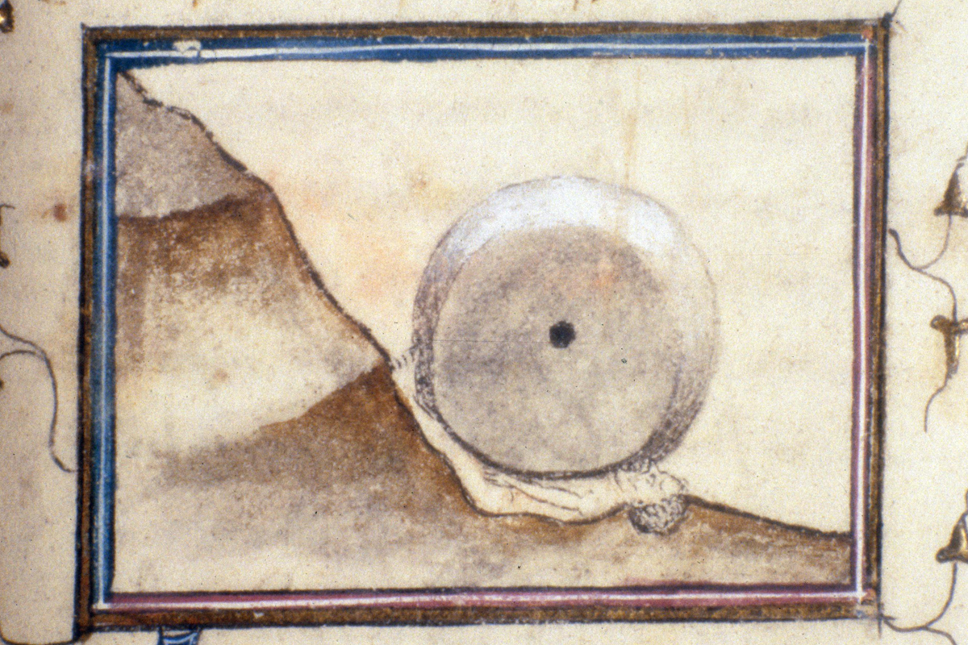
Problems with no in-house competence
 | The cost of questionnaire-based market research (survey) is increasing exponentially and offers mediocre results without an enormous question bank and harmonization with other surveys.
 | Manual data acquisition is an error-prone and boring task for humans that requires many working hours (often not credited in consultancies, law firms, or research institutes.)
 | Wrangling spreadsheet tables or word processor documents by people without data knowledge is the data Sisyphus.

Slide 5
Big data creates inequalities
Only the largest corporations, best-endowed universities, and rich governments can afford data collection and processing capacities that are large enough to harness the advantages of AI.

Slide 6
Our collaborative solutions
Our observatories are great solutions for organizations without a data specialization:
 | Organizations that cannot afford to build a large enough data team to sustain consistent, extensive data collection and processing (many large institutions and companies)
 | Who cannot hire even a single data engineer or a data scientist (medium-sized companies, NGOs)
 | Who do not even have a permanent IT function (about 2 million European small enterprises and civil society organizations)

Slide 7
Data observatories
 | We are currently building one prototype for the European Music Observatory financed by the European Union and music industry players (cc 3-4 million euros.) We would like to take over existing or start new observatories in 2 years at least 5.)
 | Our observatories are competitive, because they use high-quality open source scientific software; they exploit the new Data Governance Act and Open Data Directive, deploy web 3.0 data synchronization, and offer great value-added research products.

Slide 8
Platform products
Value added apps
The European Union, the World Bank, OECD, and UN have facilitated the creation of more than 80 so-called 'data observatories' to help companies, researchers, NGOs, and governments systematically collect data and knowledge. | The different observatories offer different types of knowledge products, such as statistical yearbooks, various apps, and database access.
Most of them use web 1.0 technologies, inefficient knowledge accumulation. Already 20 of them have been discontinued. | We are developing software solutions that exploit our platforms: we harmonize surveys, statistical data, automate research reporting, elements of market monitoring or ESG reporting.
We are currently building one prototype for the European Music Observatory financed by the European Union and music industry players (cc 3-4 million euros.) We would like to take over existing or start new observatories in 2 years at least 5) | Each observatory gives us intimidate customer access to 3-4 large universities, 1-2 large consultancies, and various specialist institutions.

Slide 9
Platform products
Value added apps
The European Union, the World Bank, OECD, and UN have facilitated the creation of more than 80 so-called 'data observatories' to help companies, researchers, NGOs, and governments systematically collect data and knowledge. | The different observatories offer different types of knowledge products, such as statistical yearbooks, various apps, and database access.
Most of them use web 1.0 technologies, inefficient knowledge accumulation. Already 20 of them have been discontinued. | We are developing software solutions that exploit our platforms: we harmonize surveys, statistical data, automate research reporting, elements of market monitoring or ESG reporting.
We are currently building one prototype for the European Music Observatory financed by the European Union and music industry players (cc 3-4 million euros.) We would like to take over existing or start new observatories in 2 years at least 5) | Each observatory gives us intimidate customer access to 3-4 large universities, 1-2 large consultancies, and various specialist institutions.

Slide 10
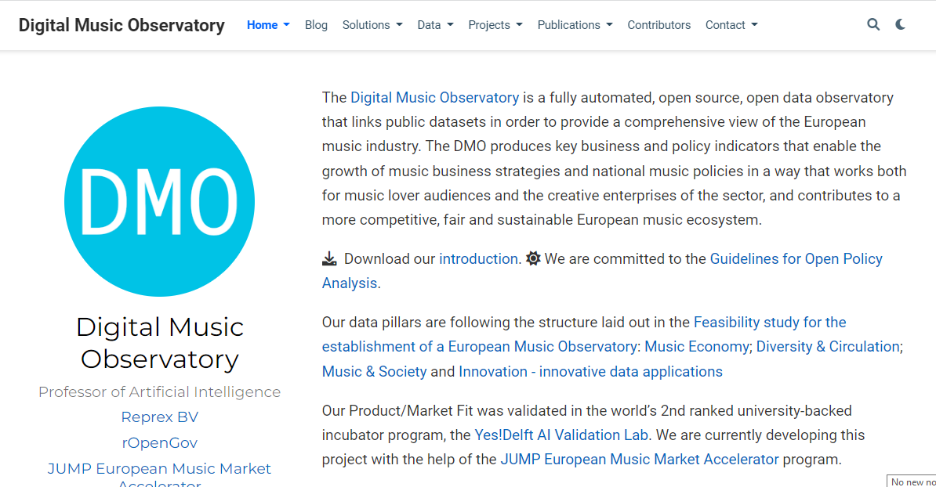
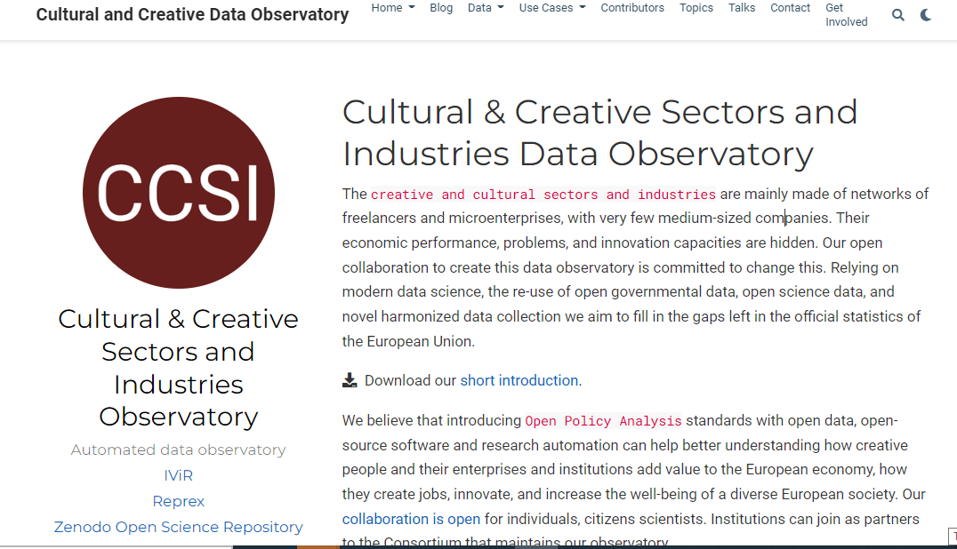
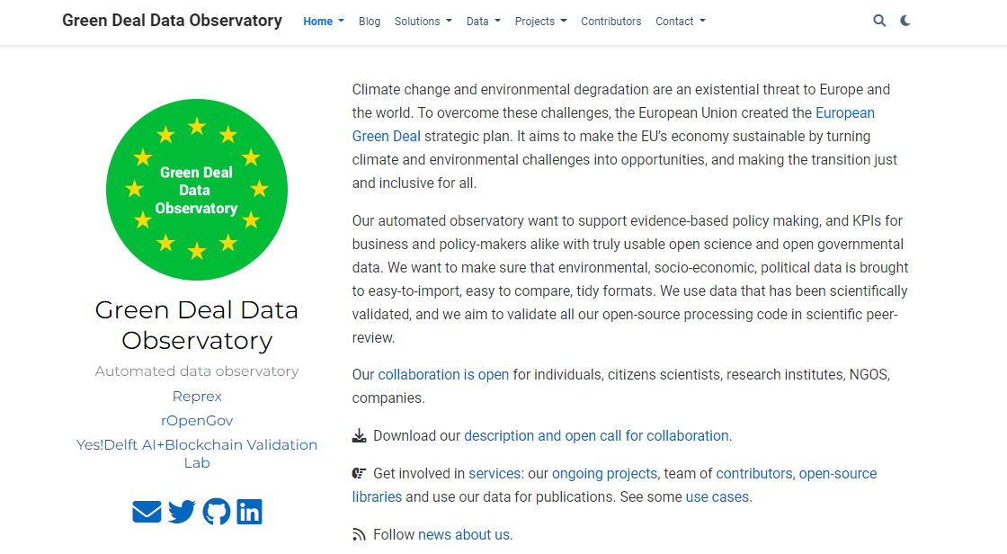
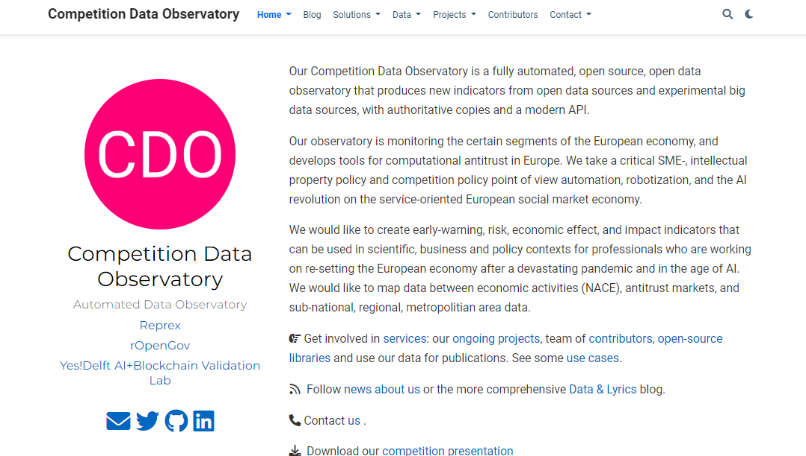
Marketing strategy
 | Buma/Stemra like copyright management agencies, music export offices, festivals and venues, University of Amsterdam, Sant’Anna, Economic University of Bratislava, ministries of culture, grant agencies.
 | University of Amsterdam, Europeana, Sant’Anna, Hungarian Film Fund,
 | Connected financial and sustainability reporting: bank consultancies, big four audit companies, large environmental NGOs.
 | Antitrust agencies, law firms, economics consultancies working with mergers and other competition related issues.

Slide 11
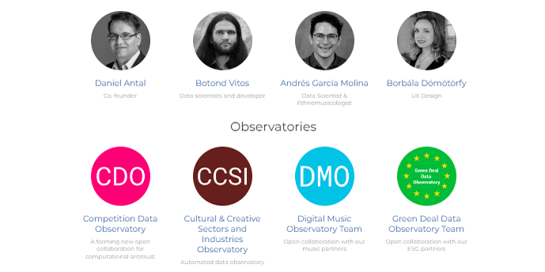
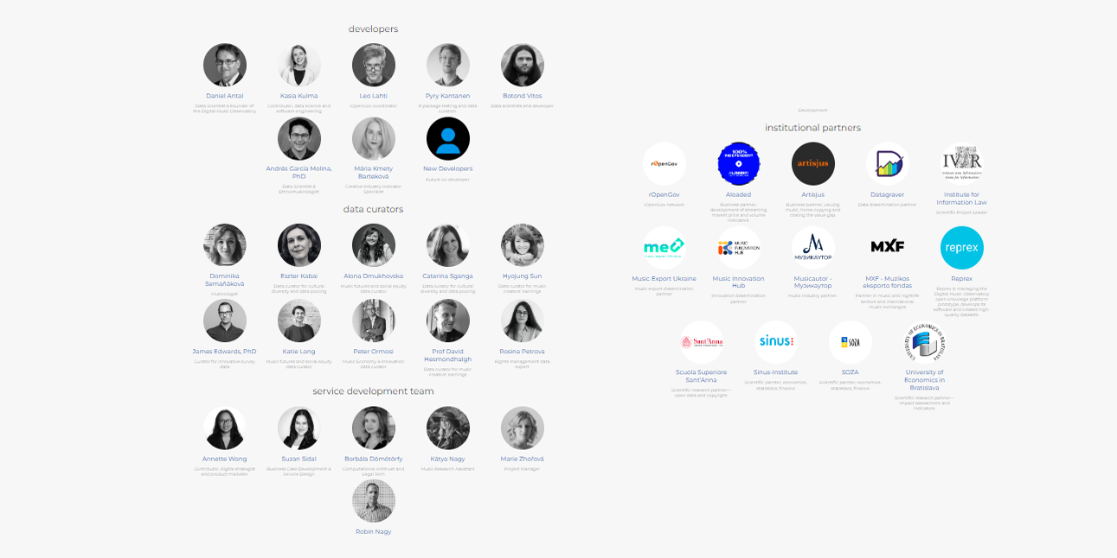
Team
 | The two co-founders, Daniel Antal, CFA and Andrés García Molina, PhD, and the core team manage the ecosystems' development, develop knowledge management, and direct the software development.
 | Each observatory has a broader team of users, data and knowledge curators, and developers. The most developed Digital Music Observatory has 16 institutional users and a team of about 20 music and data professionals. The newer observatories have a smaller, initial service development and data curatorial team.

Slide 12
Reprex: a modern data observatory

Slide 13
There are more than 60 functional, and about 20 already discontinued data observatories, i.e. long-term, usually triangular (business, academic, policy) data collection institutions recognized by the EU, OECD or UNESCO, including the European Observatory on Infringements of Intellectual Property Rights or the European Audiovisual Observatory.

Slide 14
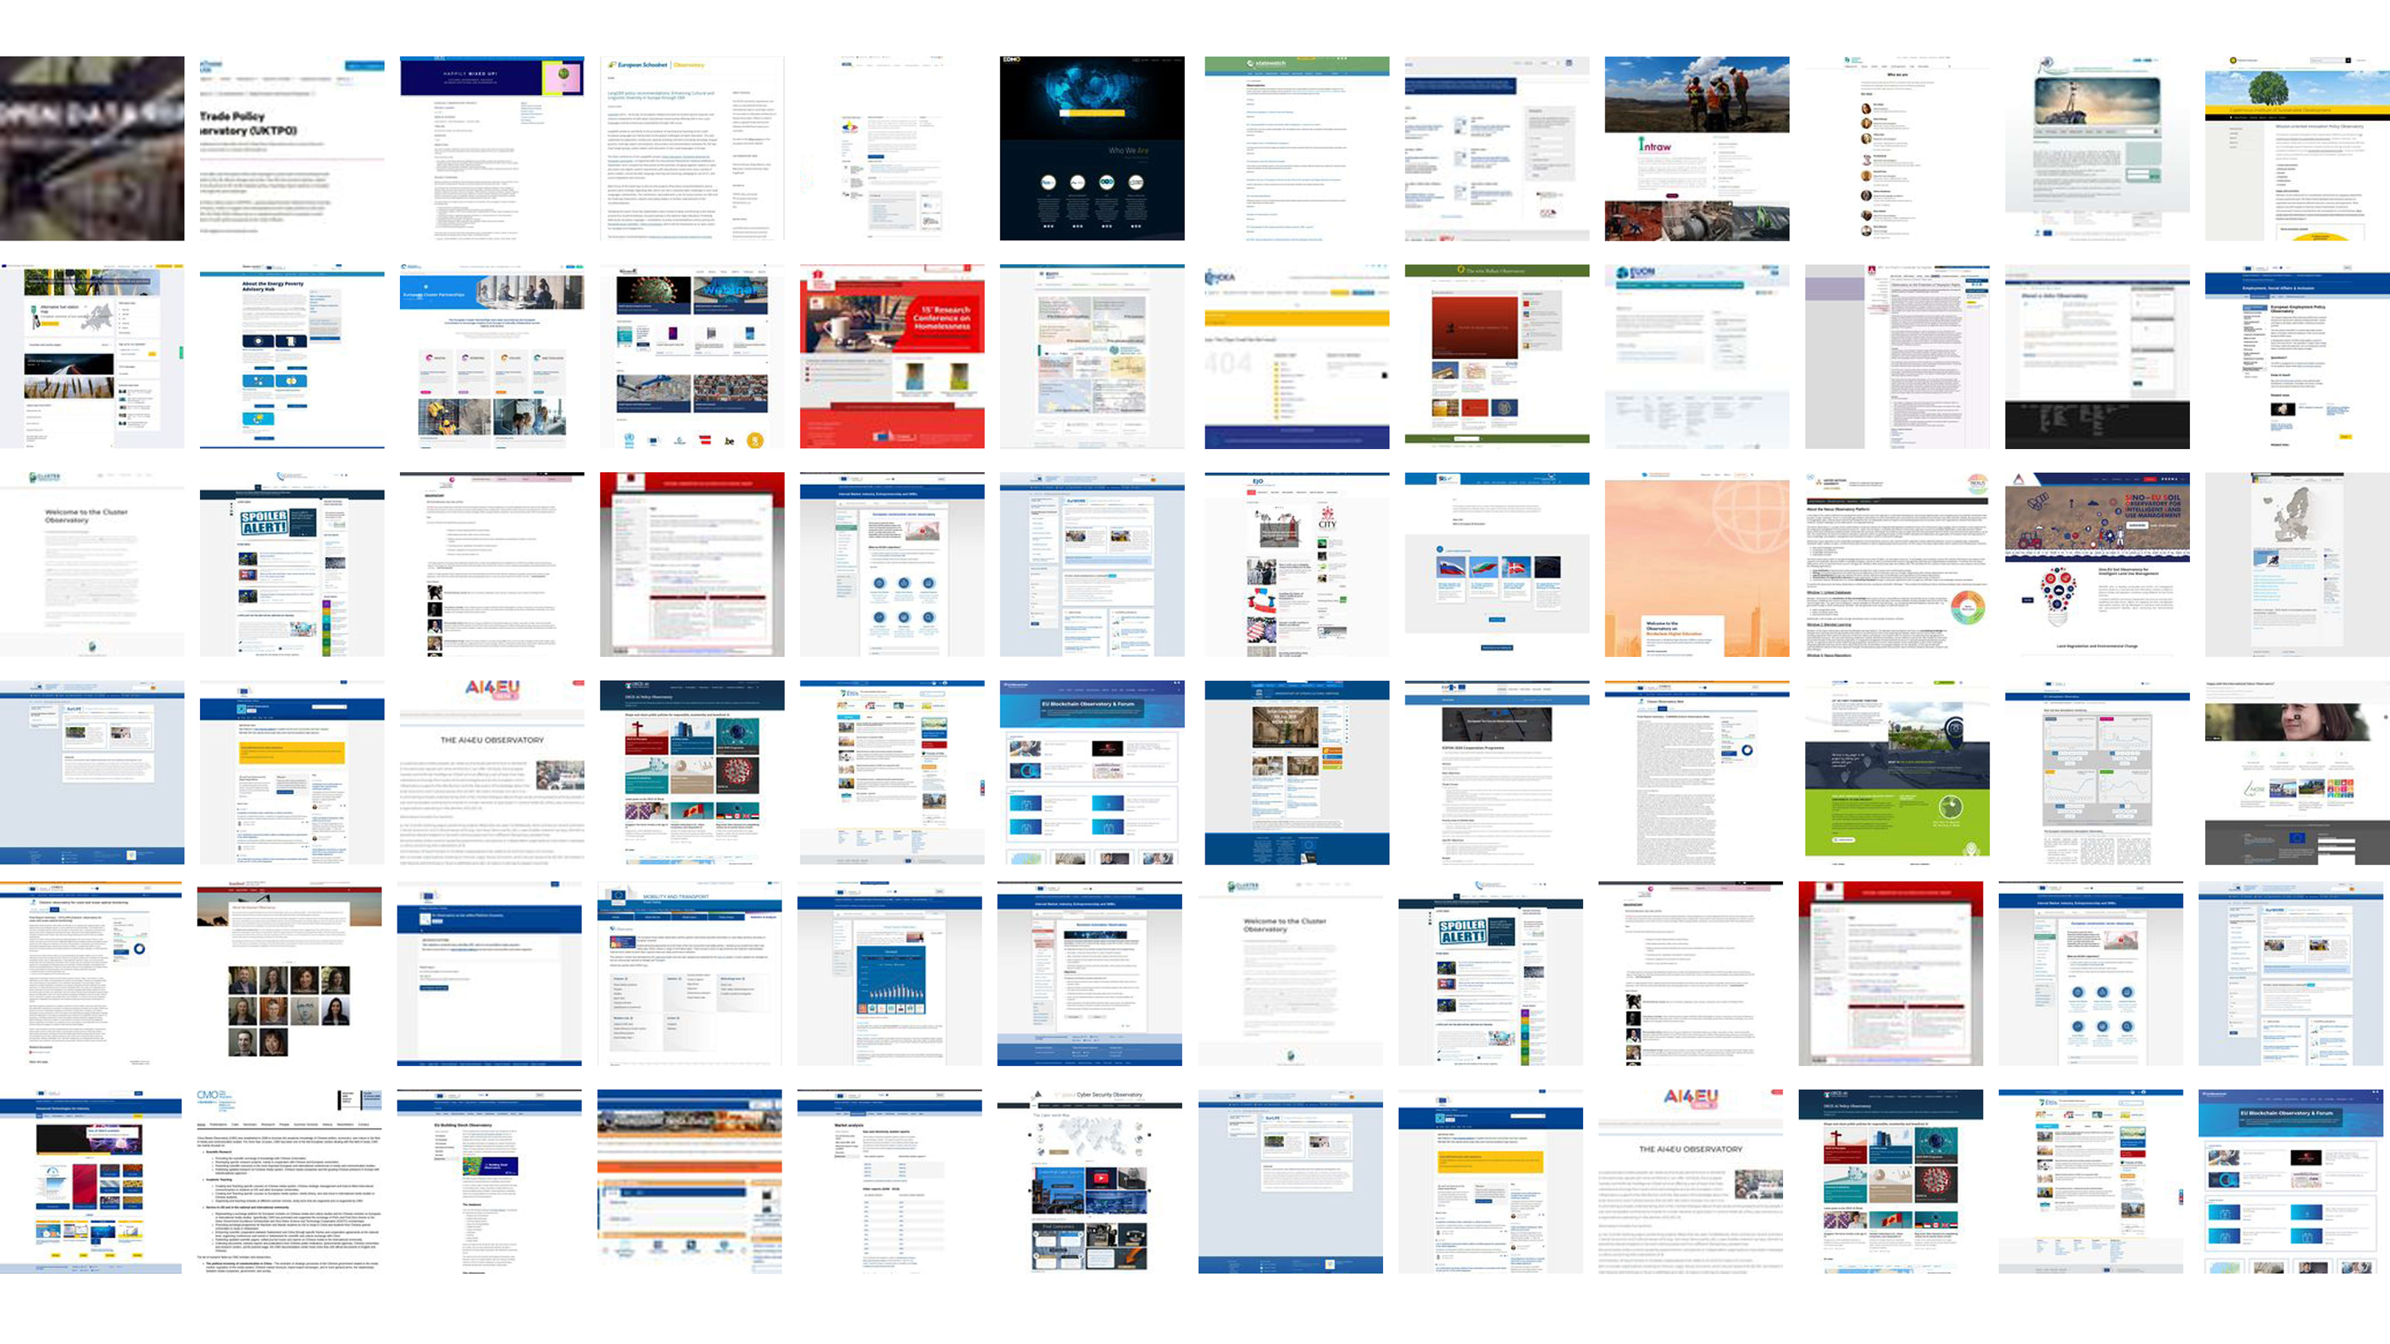
Reprex aims to create a modern, web 3.0 compatible, open-data driven interpretation of the EU/UNESCO data observatory concept that meets the Principles of Open Scholarly Infrastructure. Our minimum viable product is the Digital Music Observatory.

Slide 15
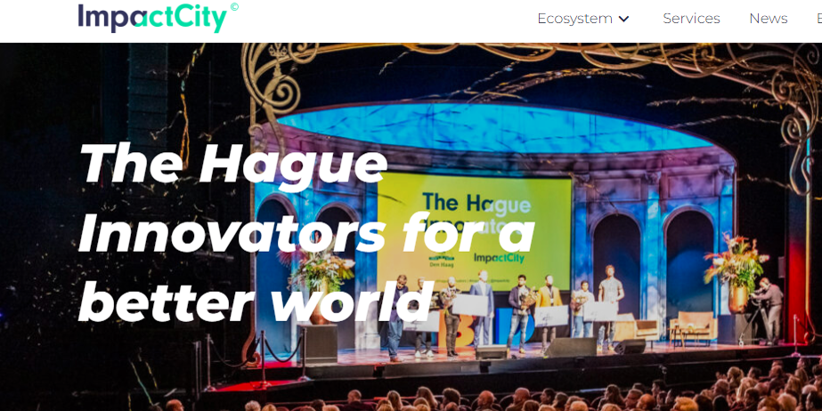
The Hague is the winner of the World Smart City Award in 2021. Reprex aims to connect Europeana, PAARD and other Hague organizations to global knowlege graphs, open science repostitories, innovative SDG web servies and eventually attract the planned European Music Observatory into our beautiful and smart city.

Slide 16
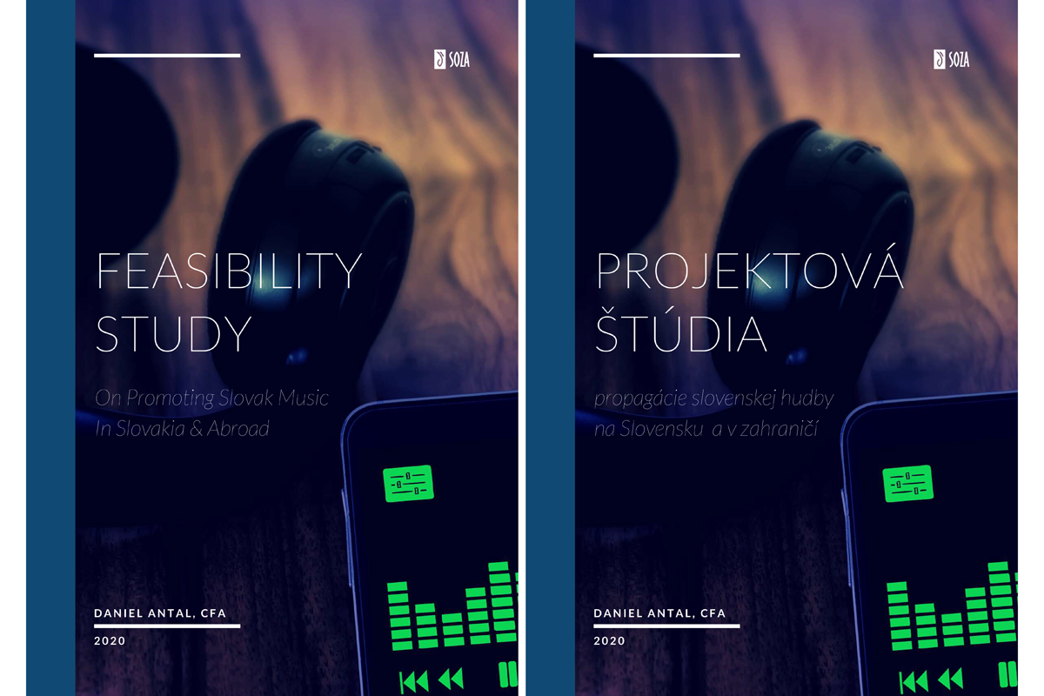
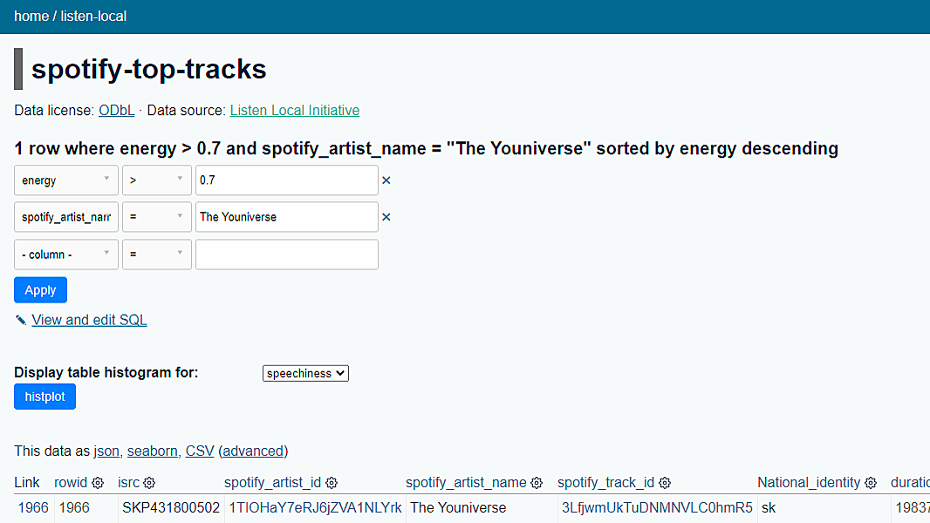
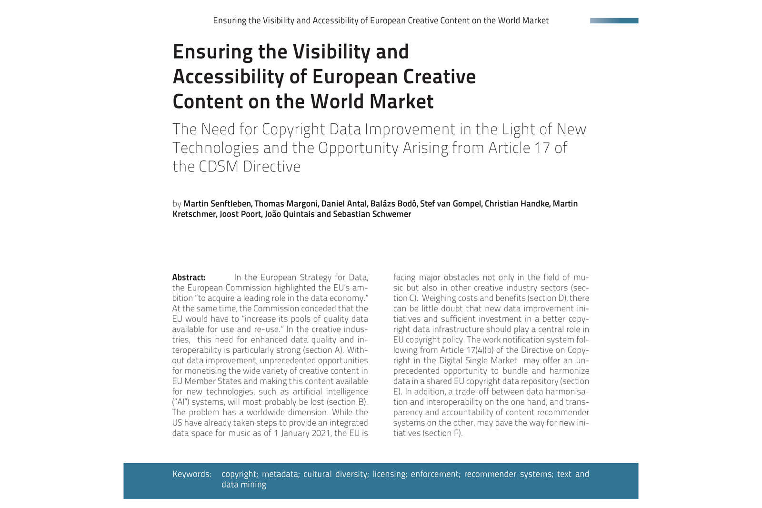
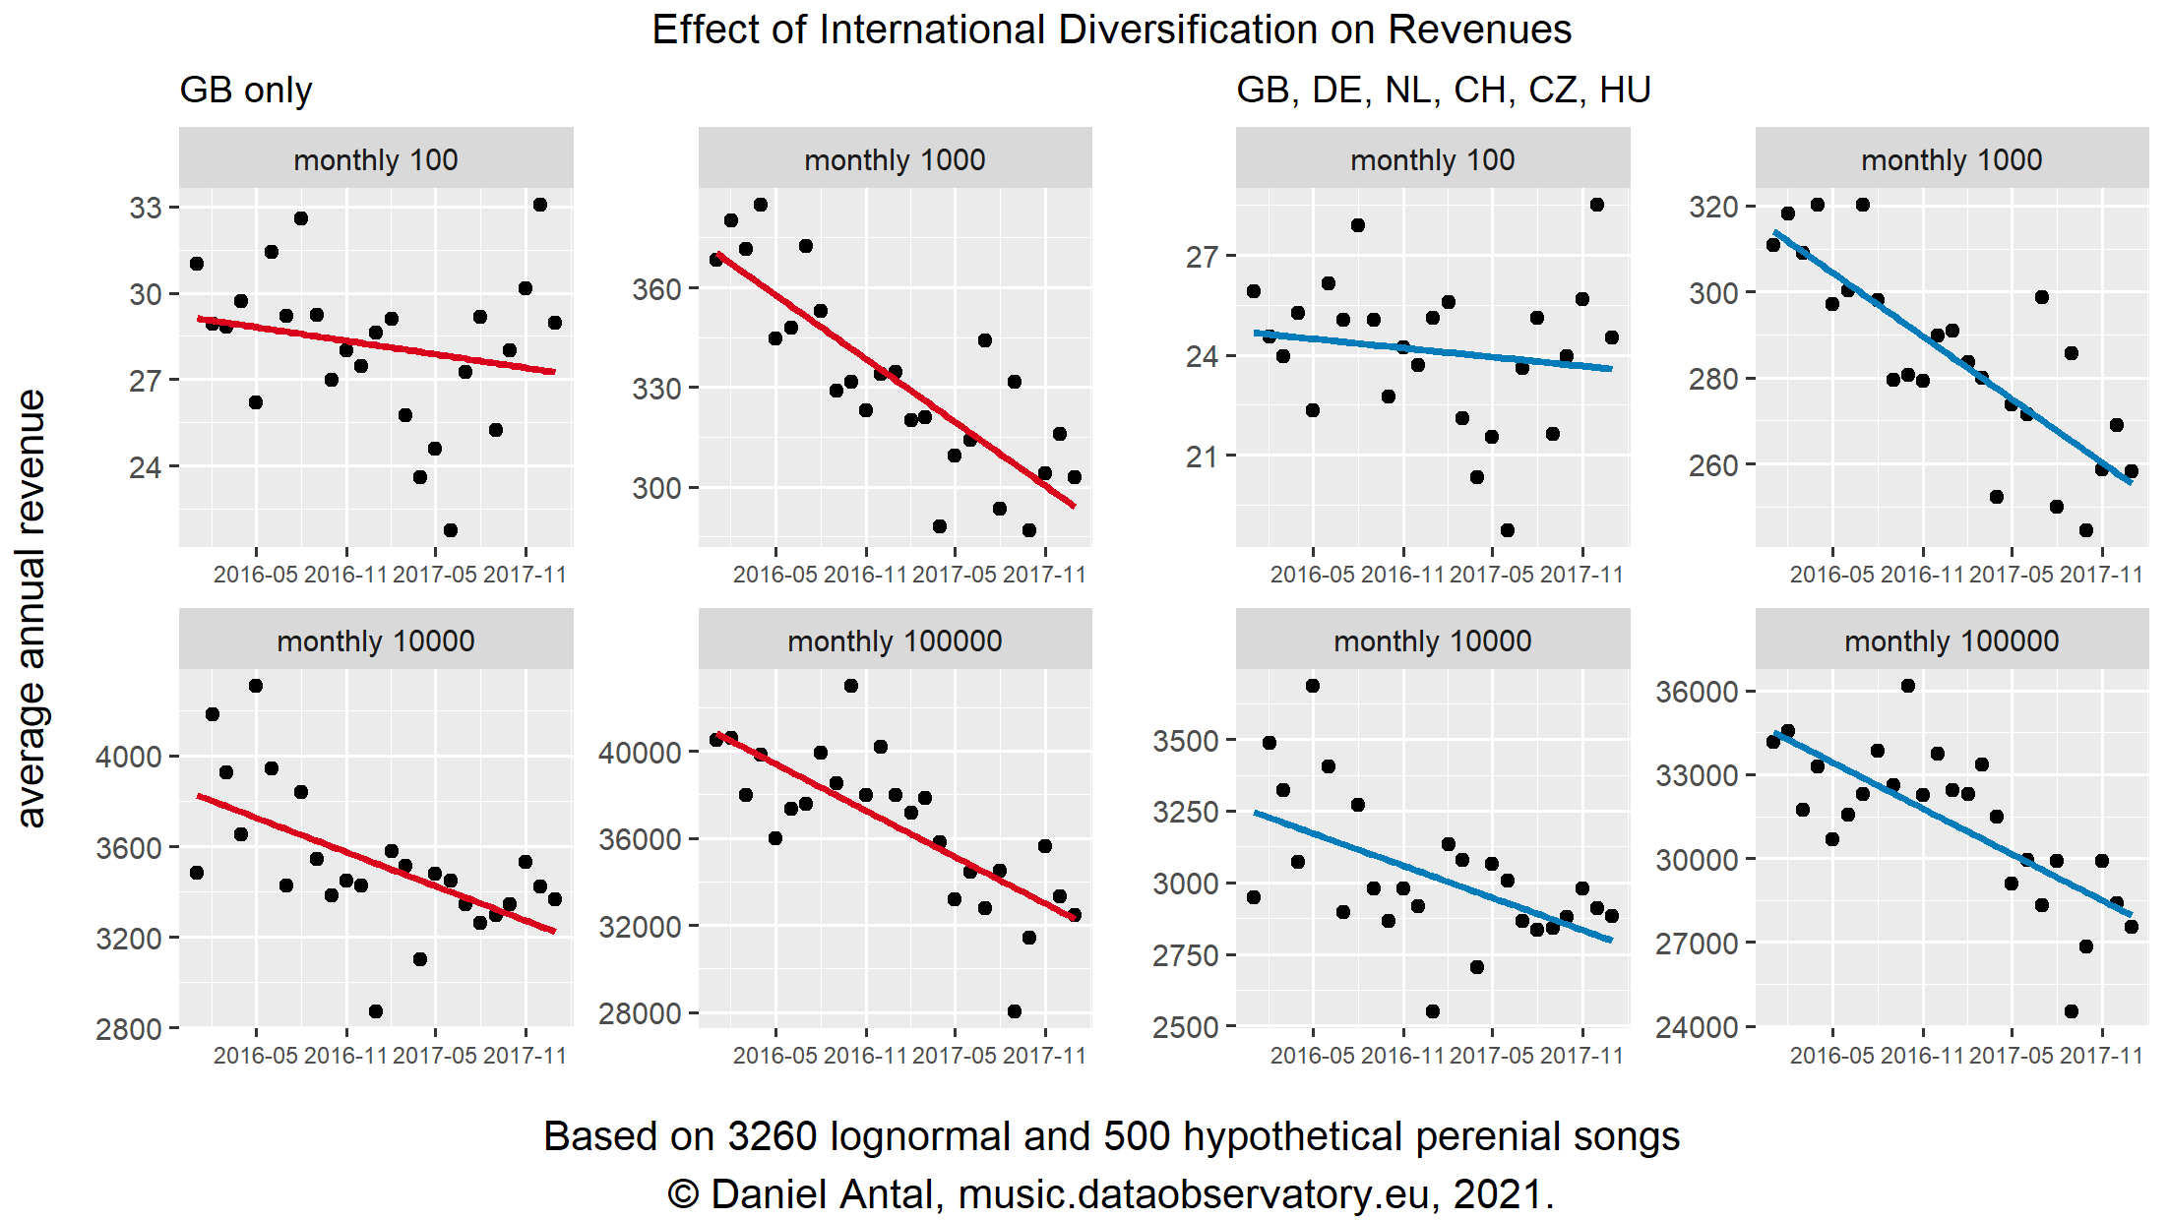
Listen Local make regional music repertoires globally visible and avoid biases
Reprex’s Listen Local promotos best practice of trustworhty AI and policy tool for improving diversity in music. It is features in the UK Trustworthy Autonomous Systems and the EU Horizon Europe R&D programs, and as a service for creators and cultural heritage CSOs in the MusicAIRE Creative Europe program.

Slide 17
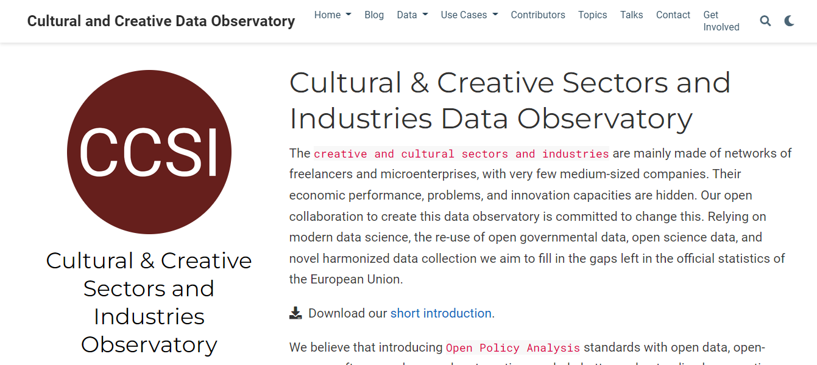
CCSI is an unfunded project originating in RECREO
The CCSI Data Observatory is a currently unfunded project element of RECRECO, a joint project with IViR, Europeana, and other organizations that did not get funding. Many elements of this project can be created with synergies of the already funded MusicAIRE and OpenMusE projects

Slide 18
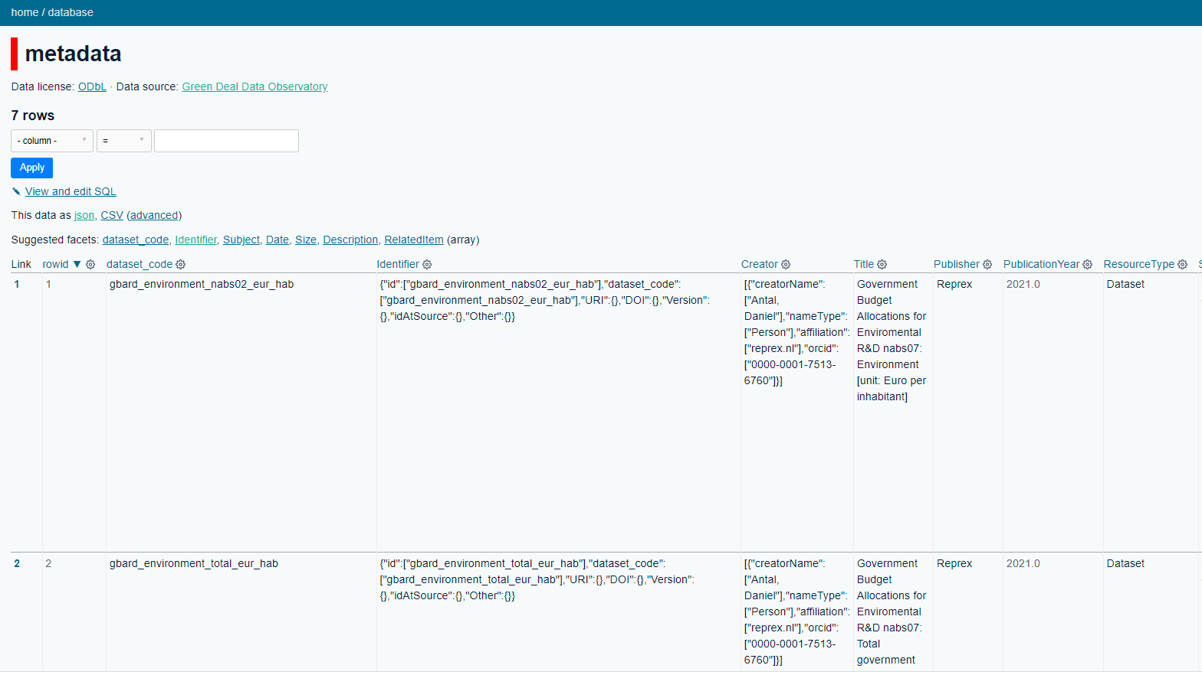
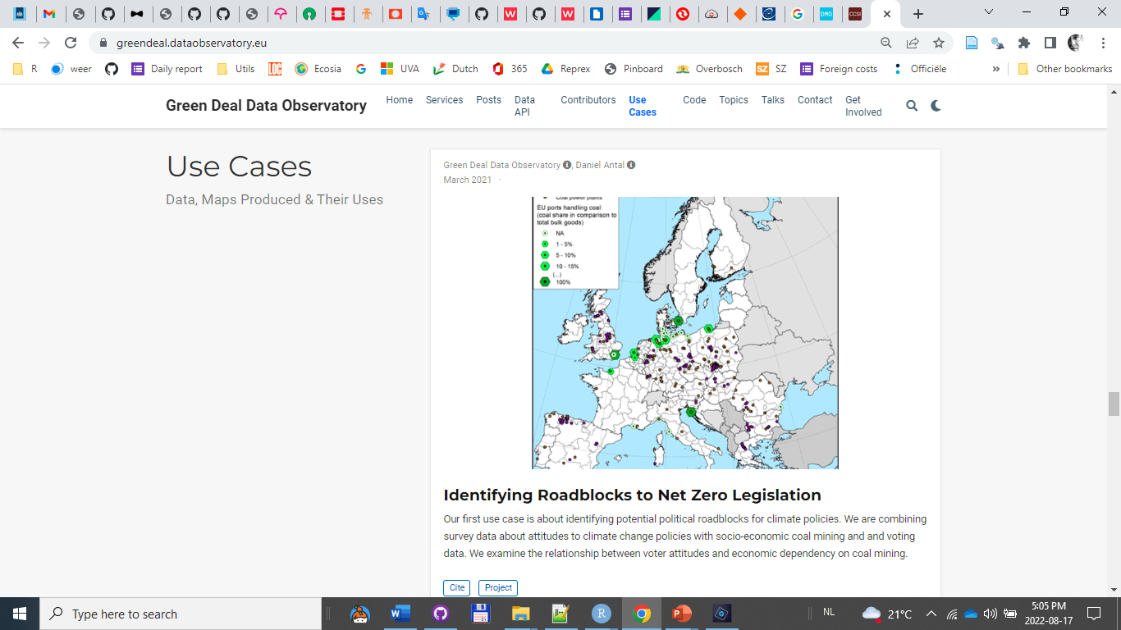
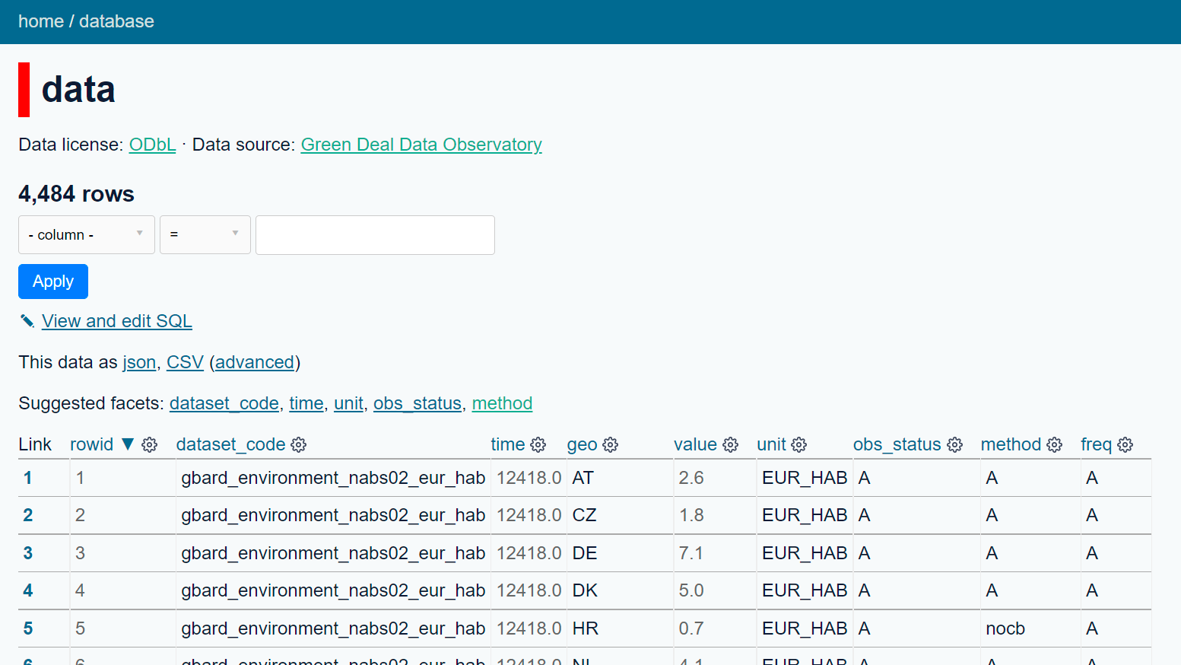
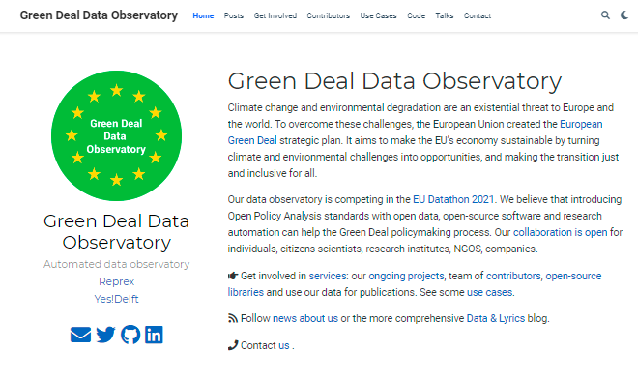
The Green Deal Data Observatory can add ecological context to Europeana
The Green Deal Data Observatory is our new data ecosystem that is mainly focusing on environmental and social impact analysis. We have developed an EEIO application from our economic impact analysis software designed for the Slovak music and the Hungarian film industry.

Slide 19
Reprex: a modern data observatory
Develop our data observatories as Open Scholarly Infrastructure
Place our Digital Music Observatory, Cultural and Creative Sectors Industries Data Observatory, and Green Deal Data Observatory on knowledge graphs of Europeana, Wikidata, and various national libraries.
Achieve EU/UNESCO/OECD recognition for our lively, self-governing, triangular policy-science-business data ecosystems as data observatories.
Harmonize research artefacts with open repositories such as Zenodo and Figshare.

Slide 20
Impact City
Develop our data observatories as Open Scholarly Infrastructure
Place our Digital Music Observatory, Cultural and Creative Sectors Industries Data Observatory, and Green Deal Data Observatory on knowledge graphs of Europeana, Wikidata, and various national libraries.
Achieve EU/UNESCO/OECD recognition for our lively, self-governing, triangular policy-science-business data ecosystems as data observatories.
Harmonize research artefacts with open repositories such as Zenodo and Figshare.

Slide 21
Observatory specific

Slide 22
Why is Open Data Not Used?
Data is exponentially more valuable in integration than in isolation; unfortunately, open data is very difficult to join with other data. Open data almost never conforms to tidy data principles, which makes integration into databases or making composite indicators a very challenging data processing task.
Haphazard use of measurement units (gram vs kilogram), currencies, metadata codes (regional boundaries change several thousand times just in the EU over a few years.)
In short: open data requires investment into processing, unit testing, and documentation to be usable. These are very costly operations, but we believe they can be done at scale and at a best value for money with open-source statistical code and research automation. This is what we do: create automated data observatories that reprocess, validate, and automatically document open data to meet high statistical standards.

Slide 23
Why is open data not trusted?

Slide 24
Why is Open Data Not Trusted?
Data is most valuable when it can be linked with other data; unfortunately, open data is very difficult to join with other data. Open data almost never conforms to tidy data principles, which makes integration into databases or making composite indicators a very challenging data processing task.
Haphazard use of measurement units (gram vs kilogram), currencies, metadata codes (regional boundaries change several thousand times just in the EU over a few years.)
In short: open data requires investment into processing, unit testing, and documentation to be usable. These are very costly operations, but we believe they can be done at scale and at a best value for money with open-source statistical code and research automation. This is what we do: create automated data observatories that reprocess, validate, and automatically document open data to meet high statistical standards.

Slide 25
Why is Open Data Not Trusted?
Open data is released after primary governmental, scientific, or corporate use. It is not processed and organized to meet the needs of new users.
The data is poorly documented. Primary users do not have an incentive to hire a data scientist or statistician to provide important metadata for the information: it needs to be reverse engineered to figure out important aspects of the data.
The EU, OECD, and UN bodies (co-)finance more than 60 permanent data collection points, so called ‘observatories’ or ‘data observatories’. Our market research found they almost never use any form of open data. We believe that this is a wasted opportunity to spend millions of euros on each data observatory’s collection program when billions worth of open data (at historical cost) is not even considered as a source.

Slide 26
How can we build up the missing trust?

Slide 27


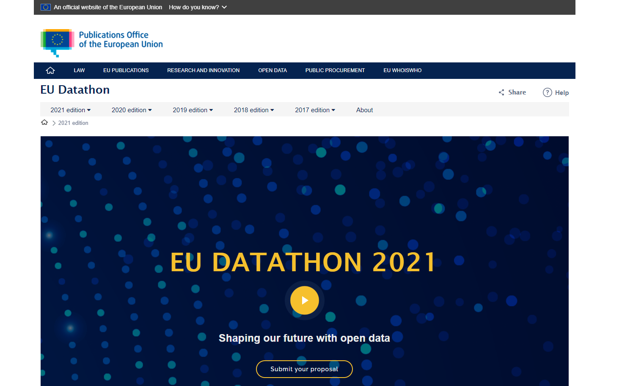
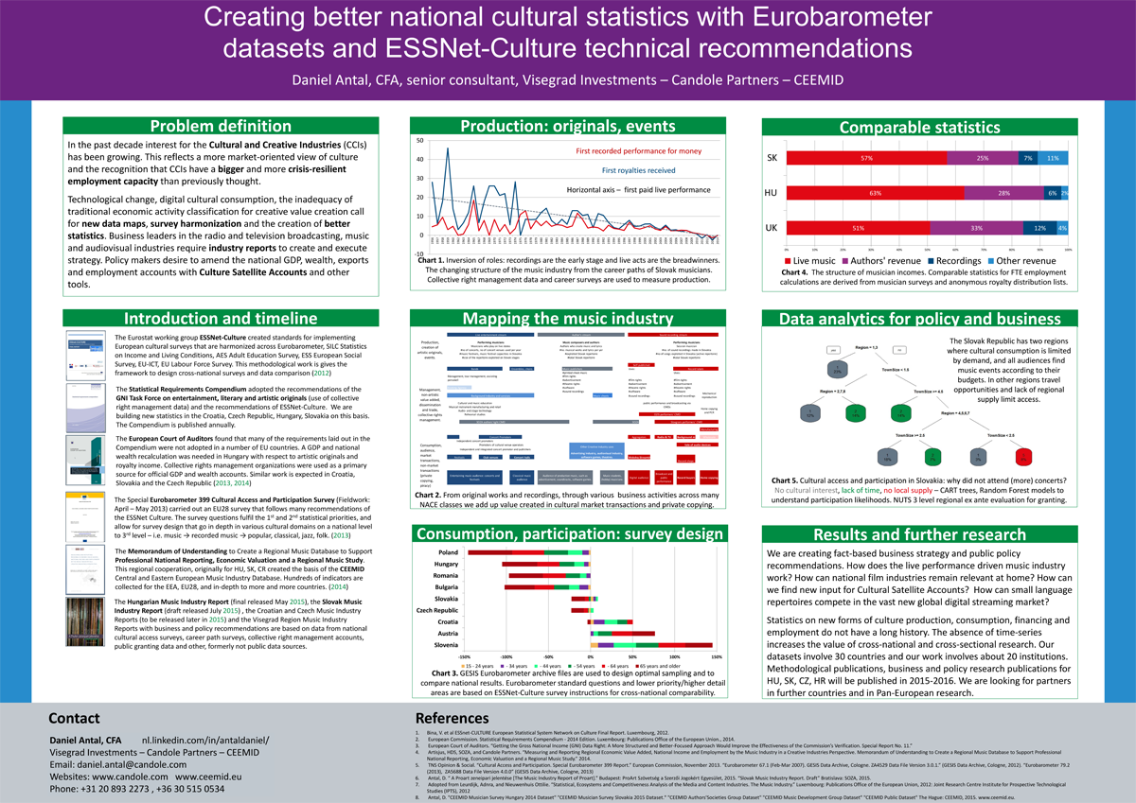
OSINT & Open-Source Market Research
We do what bellingcat does with open-source intelligence in journalism: programmatically sift through vast mountains of open data and try to select and verify those that meet high business, scientific, or policy evidence standards.

Slide 28
Accuracy & Reliability
1 . Our curators design unit-tests and other statistical tests to check the accuracy and reliability of our indicators before release.
2. Our curators send the data products for in-context peer review in their domain.
1 . Our statistical software code contains many unit-tests to avoid reliability issues.
2. Our processing code goes through scientific software peer-review.
3. The authoritative copy/version is stored on Zenodo with DOI/version.
Timeliness & punctuality
1 . Our curators help us find frequently updated data sources.
2. We aim to design leading indicators that accurately forecast the expected measurements.
1. We use research automation: our code collects new data, performs revisions every day, and re-processes the data.
2. Our API immediately releases the new data.
Coherence & Comparability
1 . Our curators select data and design indicators that can be joined with all other indicators in our observatory.
2. We make sure that the timeframe, unit, currency, and other aspects make the data comparable.
1 . Our software + API fully embraces the tidy data concept. Our processes integrate our data seamlessly and make linking with other databases easier and less likely to cause logical errors.
2. We aim for a large cross-section of observations (all Europe), timeframe, and several indicators for cross-comparison.
Accessibility & Clarity
1 . Our curators place our data in scientific publications, open policy analysis, and business use cases to make sure that our data is robust and meaningful.
2. Our open collaboration method offers user feedback from academia, as well as public and NGO policy and business users.
1 . Our API contains a daily refreshed full set of indicators (we aim at 100-200 indicators in the observatory)
2. Our documentation website automatically refreshes indicator descriptions, data overviews, and the latest metadata (new observations, new imputations, etc.)
We aim to increase the quality of existing open governmental indicators, such as Eurostat products, and to design new indicators that are at least on the quality level of Eurostat’s products. Our quality assurance follows the following methodology.
1. Towards a harmonised methodology for statistical indicators — Part 1: Indicator typologies and terminologies - 2014 edition (pdf)
2. Towards a harmonised methodology for statistical indicators — Part 2: Communicating through indicators (pdf) 3. Towards a harmonised methodology for statistical indicators — Part 3: Relevance for policy making (pdf)

Slide 29
What is our technology?

Slide 30
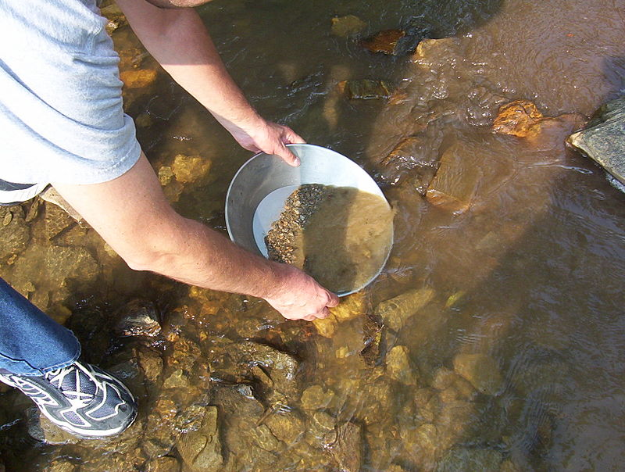
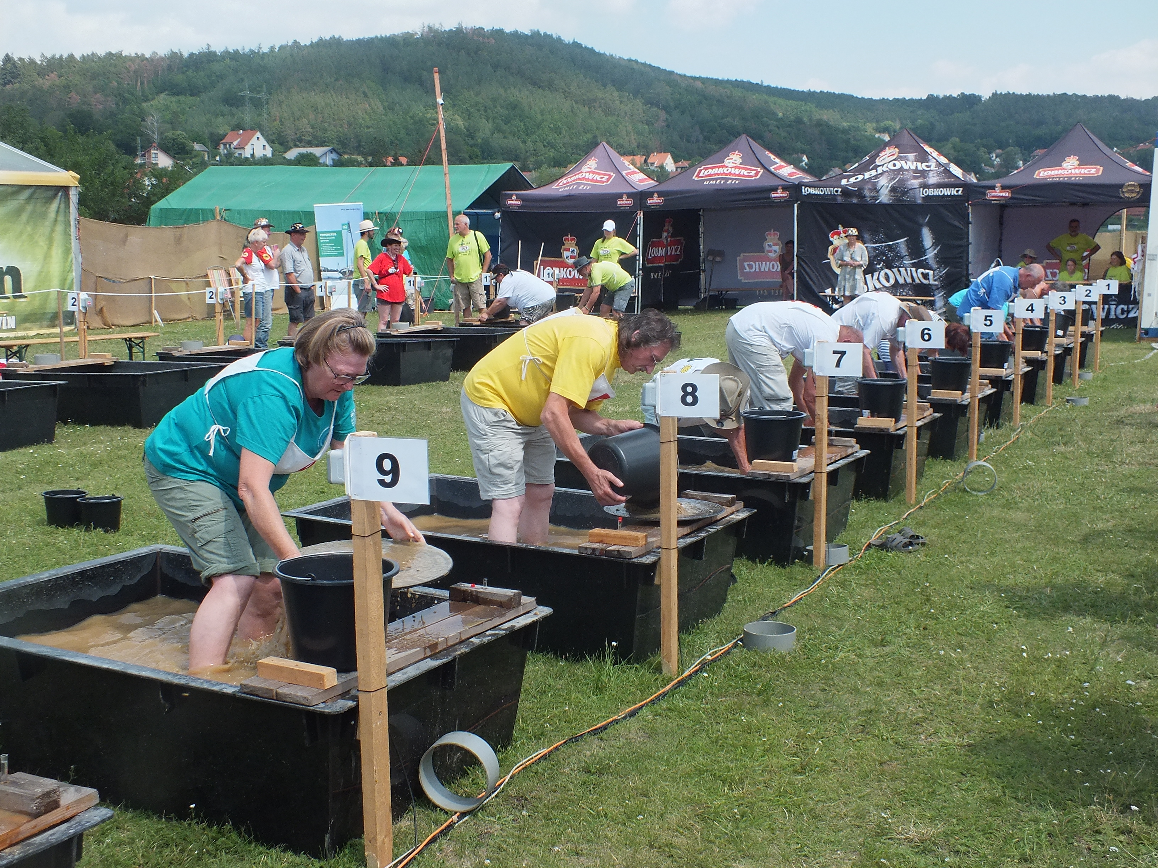
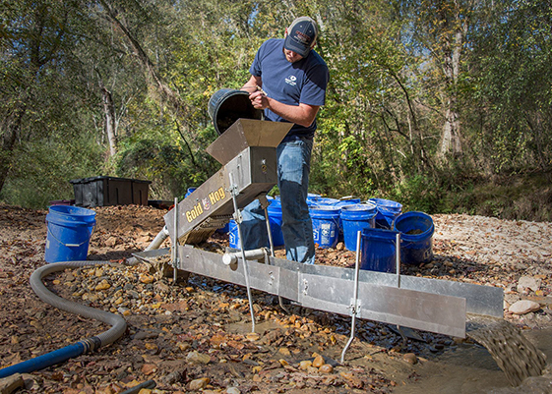
Technology – panning out gold from muddy open sources
Collect
retroharmonize
regions
Re-process
Recode/ transform
Impute, correct
Release
Automatic documentation
Placement in research projects
Iotables
R/Phython
Data API
Validate, test
Our retroharmonize, regions, and iotables software packages each have about 1000-2000 specialist users worldwide.
The users are potential collaborators to pan out more open data and potential clients to produce high-quality research products.

Slide 31
rOpenGov slide
Combining ex ante and ex post survey harmonization allows creating small scale surveys, such as simpler online surveys, that are more representative, or fully representative of a population.
This method combines new research information with pre-existing information, for example, in the European Values Survey, Eurobarometer, Afrobarometer, EU LFS, etc.

Slide 32
Kasia curated list slide
Combining ex ante and ex post survey harmonization allows creating small scale surveys, such as simpler online surveys, that are more representative, or fully representative of a population.
This method combines new research information with pre-existing information, for example, in the European Values Survey, Eurobarometer, Afrobarometer, EU LFS, etc.

Slide 33
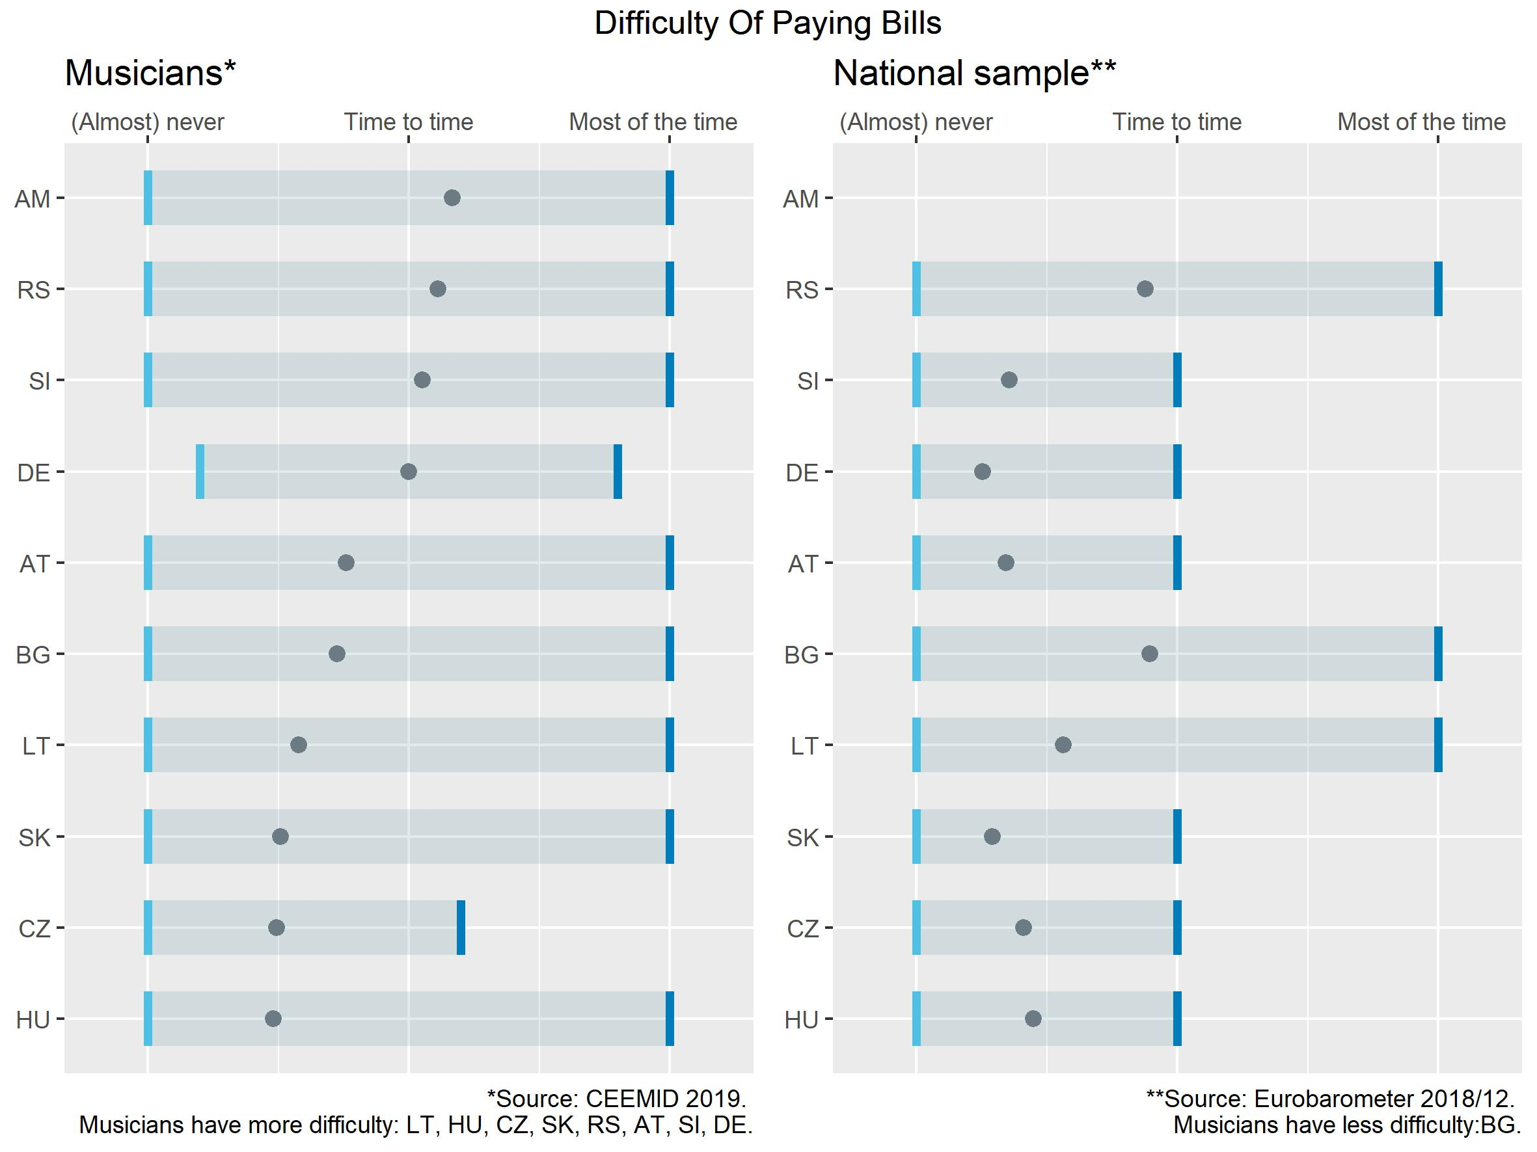
Ex Ante Survey Harmonization
Combining ex ante and ex post survey harmonization allows to create small scale surveys, such as simpler online surveys, that are more representative, or fully representative of a population.
This method combines new research information with pre-existing information, for example, in the European Values Survey, Eurobarometer, Afrobarometer, EU LFS, etc.

Slide 34
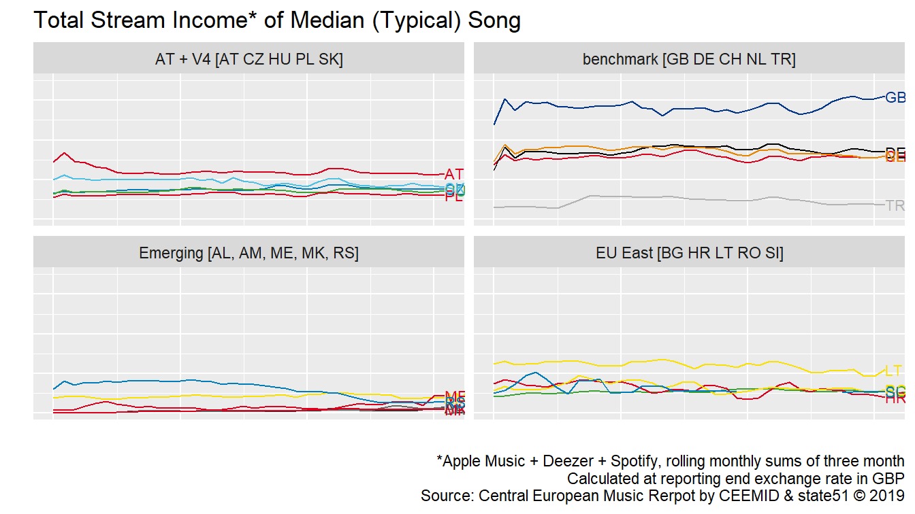
Systematic Sampling of Big Data
Many researchers know how to query the Spotify or YouTube API, but how to do it in a representative and reproducible manner?
The income of a typical song in 20 countries, 2015-2019, monthly values.

Slide 35
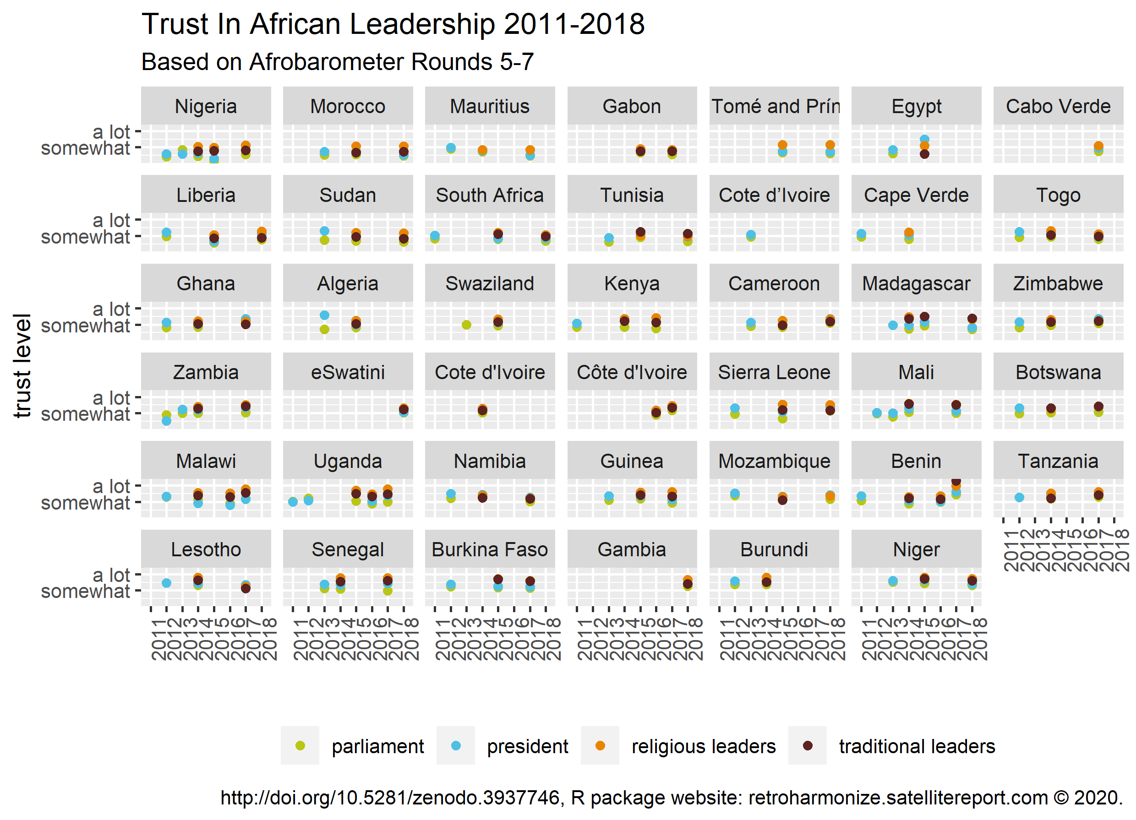
Ex Post Survey Harmonization
Ex post survey harmonization allows the combination of pre-existing micro-level data, either published, or available for researchers, for example in the Eurostat microdata research.
It can combine international datasets without having to commission a new survey.

Slide 36
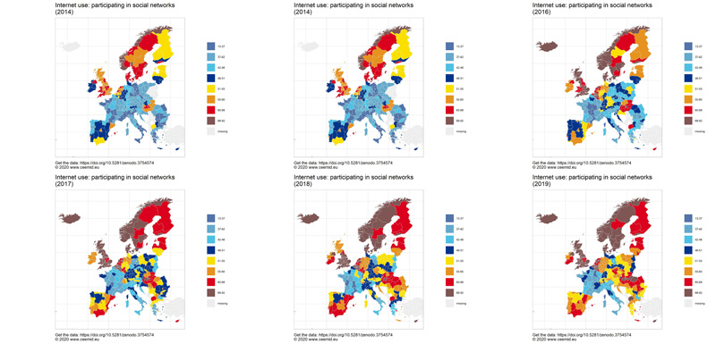
New Statistical Indicators
Statistical agencies and governments collect significantly more data than what eventually is released as statistically aggregated data products (for example, the GDP or regional GDP indicator, literacy indicators, etc.)
Via rOpenGov and our peer-reviewed statistical software packages, we have access to the raw data of Eurostat and other governmental and scientific agencies covered by the EU Open Data Directive, or similar legislation in other jurisdictions, and using the very same methodology of Eurostat, OECD, we can create similar statistical indicators ahead of the official publication date, or in details that are not published by the statistical agency.

Slide 37
What is our service?

Slide 38
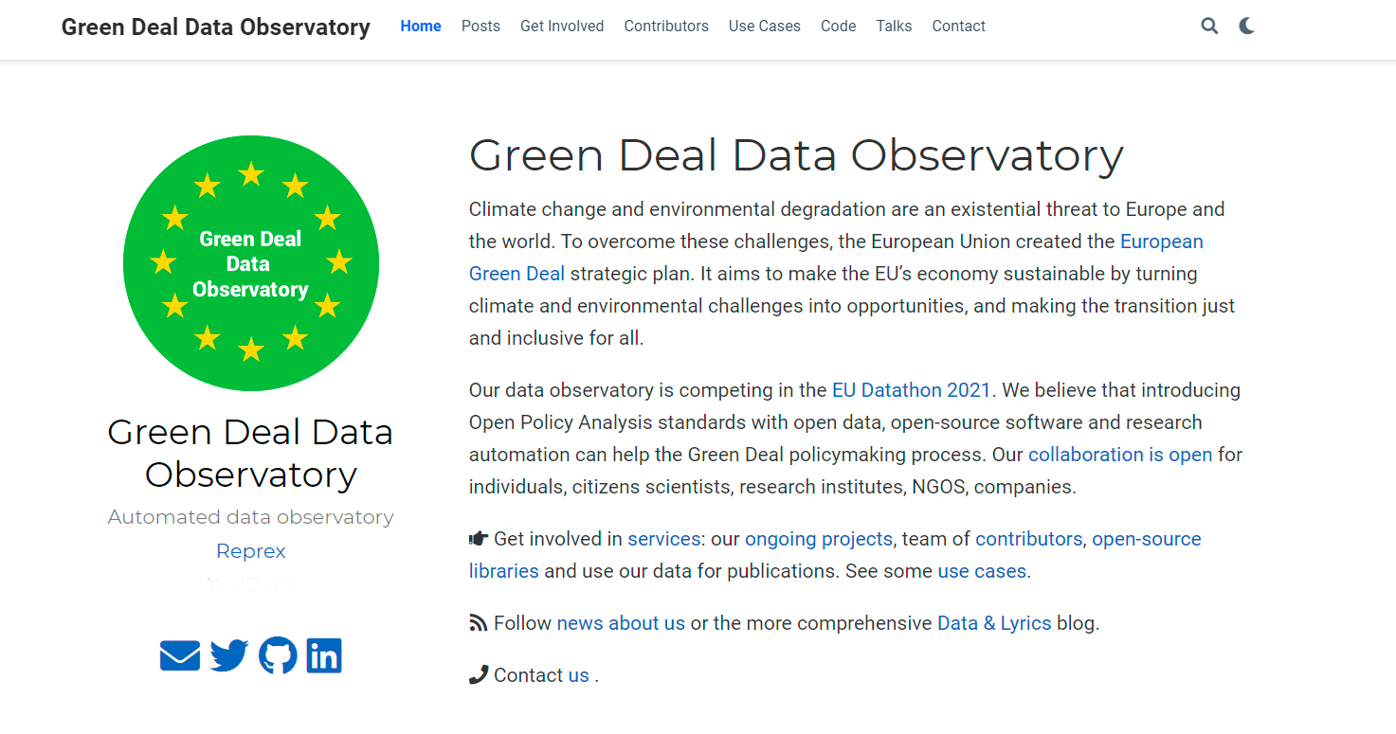
Obervatory specific screenshot

Slide 39
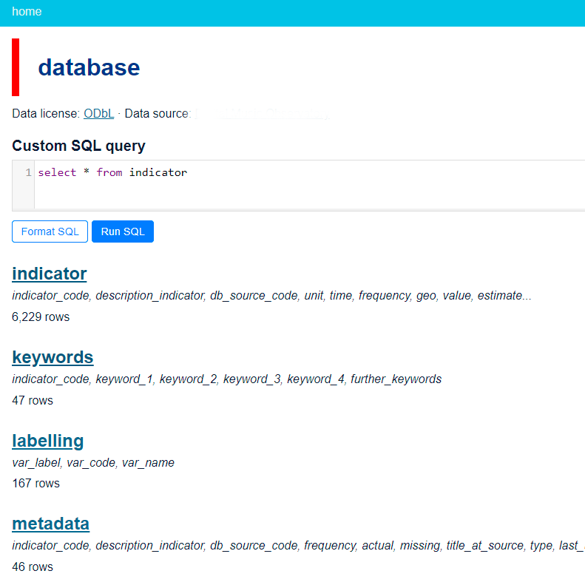
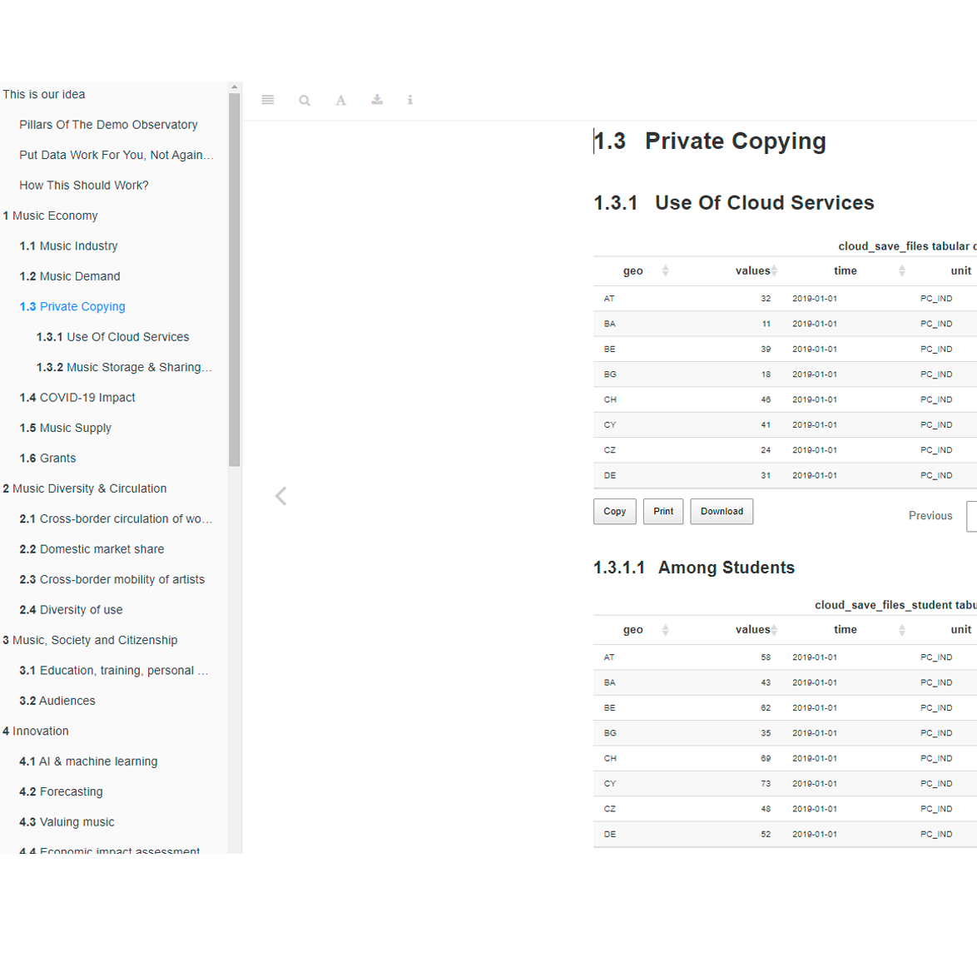
A modern, ODBL open API with daily refreshing indicators and processing and descriptive metadata. Download via SQL or in simple csv tables.
A daily refreshing long-form documentation with explanations, visualizations and human readable metadata.
A dedicated community space on Zenodo for authoritative data copies with DOI.
We would like to integrate our data flow with your research workflow. Our service design team is looking forward to requests from public and NGO policy users, researchers and consultants.
Observatory specific screenshot
Observatory specific screenshot
Website with tutorials and use cases of the data from leading experts.

Slide 40
Data sources

Slide 41
Open governmental data: We access re-usable public sector information covered by the Open Data Directive and various freedom of information legislation records.
Observatory specific text
Open scientifc data: We access re-usable scientific data from the Zenodo repository
Observatory specific text
Data sharing: We are encouraging our users and data curators to share their properietary data through us. Data is exponentially more valuable in integration than in isolation. We incentivize data sharing based on 8 years of industry experience
Big data sources, satellites: We monitor various transitory but open APIs, satellite images, and other continous “big data” sources. We use novel statistical technology to capture them into permanent, reliable, and timely statistical, business, policy, or scientific indicators.

Slide 42
Obervatory specific data source list

Slide 43
Team credits

Slide 44
Obervatory specific final screenshot

